Slide 1
Micro Credit Project
Submitted by
Yashna shah

Slide 2
Problem Statement:
A Microfinance Institution (MFI) is an organization that offers financial services to low income populations. MFS becomes very useful when targeting especially the unbanked poor families living in remote areas with not much sources of income. The Microfinance services (MFS) provided by MFI are Group Loans, Agricultural Loans, Individual Business Loans and so on. Many microfinance institutions (MFI), experts and donors are supporting the idea of using mobile financial services (MFS) which they feel are more convenient and efficient, and cost saving, than the traditional high-touch model used since long for the purpose of delivering microfinance services. Though, the MFI industry is primarily focusing on low income families and are very useful in such areas, the implementation of MFS has been uneven with both significant challenges and successes.

Slide 3
Introduction
Today, microfinance is widely accepted as a poverty-reduction tool, representing $70 billion in outstanding loans and a global outreach of 200 million clients. We are working with one such client that is in Telecom Industry. They are a fixed wireless telecommunications network provider. They have launched various products and have developed its business and organization based on the budget operator model, offering better products at Lower Prices to all value conscious customers through a strategy of disruptive innovation that focuses on the subscriber. They understand the importance of communication and how it affects a person’s life, thus, focusing on providing their services and products to low income families and poor customers that can help them in the need of hour. They are collaborating with an MFI to provide micro-credit on mobile balances to be paid back in 5 days. The Consumer is believed to be defaulter if he deviates from the path of paying back the loaned amount within the time duration of 5 days. For the loan amount of 5 (in Indonesian Rupiah), payback amount should be 6 (in Indonesian Rupiah), while, for the loan amount of 10 (in Indonesian Rupiah), the payback amount should be 12 (in Indonesian Rupiah).

Slide 4
INTRODUCTION
We nee to build a model which can be used to predict in terms of a probability for each loan transaction, whether the customer will be paying back the loaned amount within 5 days of insurance of loan.
In this case, Label ‘1’ indicates that the loan has been paid i.e. Non- defaulter.
Label ‘0’ indicates that the loan has not been paid i.e. defaulter.

Slide 5
Project Goals
Analytical Problem Framing
Exploratory Data Analysis (EDA)
Visualizations
Data Pre-Processing on train and test datasets
Model/s Development and Evaluation
Performing hyper parameter tuning, saving the best model and predicting the label
Conclusion and future work discussion

Slide 6
EDA(Exploratory Data Analysis)
Dimensions of Dataset: There are 36 columns and 209593 rows in this dataset
Null Values: There are no null values in this dataset
Skewness: Skewness is present in almost every columns
Standard deviation is very high in most of the columns.
There is lot of difference between mean and 50th percentile, which means data is skewed
There is lot of difference between 75th percentile and max, which means there are outliers

Slide 7
Data Description
label : Flag indicating whether the user paid back the credit amount within 5 days of issuing the loan {1:success, 0:failure}
msisdn : Mobile number of user
aon : Age on cellular network in days
daily_decr30 : Daily amount spent from main account, averaged over last 30 days (in Indonesian Rupiah)
daily_decr90 : Daily amount spent from main account, averaged over last 90 days (in Indonesian Rupiah)
rental30 : Average main account balance over last 30 days
rental90 : Average main account balance over last 90 days
last_rech_date_ma : Number of days till last recharge of main account
last_rech_date_da : Number of days till last recharge of data account
last_rech_amt_ma : Amount of last recharge of main account (in Indonesian Rupiah)
cnt_ma_rech30 : Number of times main account got recharged in last 30 days
fr_ma_rech30 : Frequency of main account recharged in last 30 days

Slide 8
DATA DESCRIPTION
sumamnt_ma_rech30 : Total amount of recharge in main account over last 30 days (in Indonesian Rupiah)
medianamnt_ma_rech30 : Median of amount of recharges done in main account over last 30 days at user level (in Indonesian Rupiah)
medianmarechprebal30 : Median of main account balance just before recharge in last 30 days at user level (in Indonesian Rupiah)
cnt_ma_rech90 : Number of times main account got recharged in last 90 days
fr_ma_rech90 : Frequency of main account recharged in last 90 days
sumamnt_ma_rech90 : Total amount of recharge in main account over last 90 days (in Indonesian Rupiah)
medianamnt_ma_rech90 : Median of amount of recharges done in main account over last 90 days at user level (in Indonesian Rupiah)
medianmarechprebal90 : Median of main account balance just before recharge in last 90 days at user level (in Indonesian Rupiah)
cnt_da_rech30 : Number of times data account got recharged in last 30 days
fr_da_rech30 : Frequency of data account recharged in last 30 days
cnt_da_rech90 : Number of times data account got recharged in last 90 days

Slide 9
DATA DESCRIPTION
fr_da_rech90 : Frequency of data account recharged in last 90 days
cnt_loans30 : Number of loans taken by user in last 30 days
amnt_loans30 : Total amount of loans taken by user in last 30 days
maxamnt_loans30 : Maximum amount of loan taken by the user in last 30 days
medianamnt_loans30: Median of amounts of loan taken by the user in last 30 days
cnt_loans90 : Number of loans taken by user in last 90 days
amnt_loans90 : Total amount of loans taken by user in last 90 days
maxamnt_loans90 : Maximum amount of loan taken by the user in last 90 days
medianamnt_loans90: Median of amounts of loan taken by the user in last 90 days
payback30 : Average payback time in days over last 30 days
payback90 : Average payback time in days over last 90 days
pcircle : Telecom circle
pdate : Date

Slide 10
Technology Used
Hardware technology being used.
RAM : 16 GB
CPU : 11th Gen Intel(R) Core(TM) i5-1135G7 @ 2.40GHz 2.42 GHz
GPU : intel Iris Graphics
Software technology being used.
Programming language : Python
Distribution : Anaconda Navigator
Browser based language shell : Jupyter Notebook

Slide 11
Required Libraries
Numpy
Pandas
Sklearn
Matplotlib
Seaborn
Imbalance-learn
Warnings

Slide 12
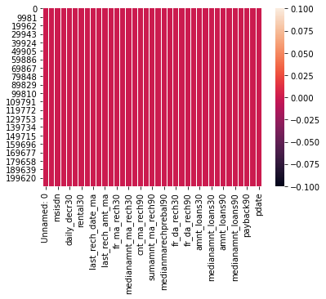
Data Visualization
Null Values

Slide 13
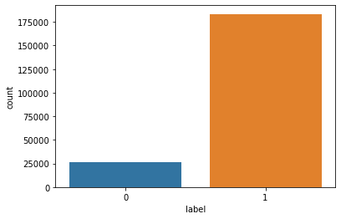
DATA VISUALIZATION
Target Variable – Label

Slide 14
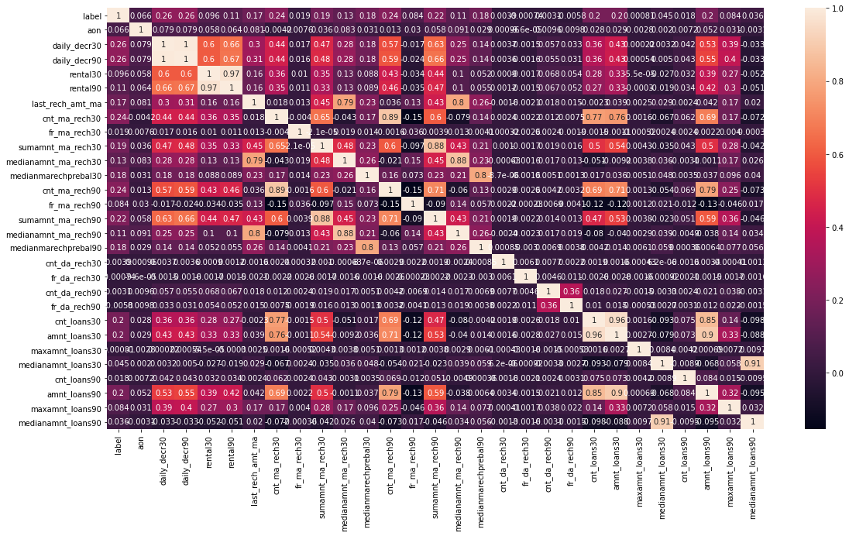
DATA VISUALIZATION
Correlation Heatmap

Slide 15
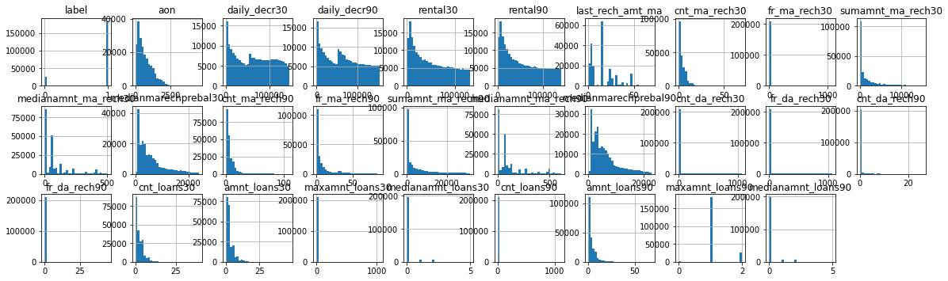
DATA VISUALIZATION
Multivariate Analysis :
I used the histogram to check through all the column details ensuring that the distribution is displayed for further analysis

Slide 16
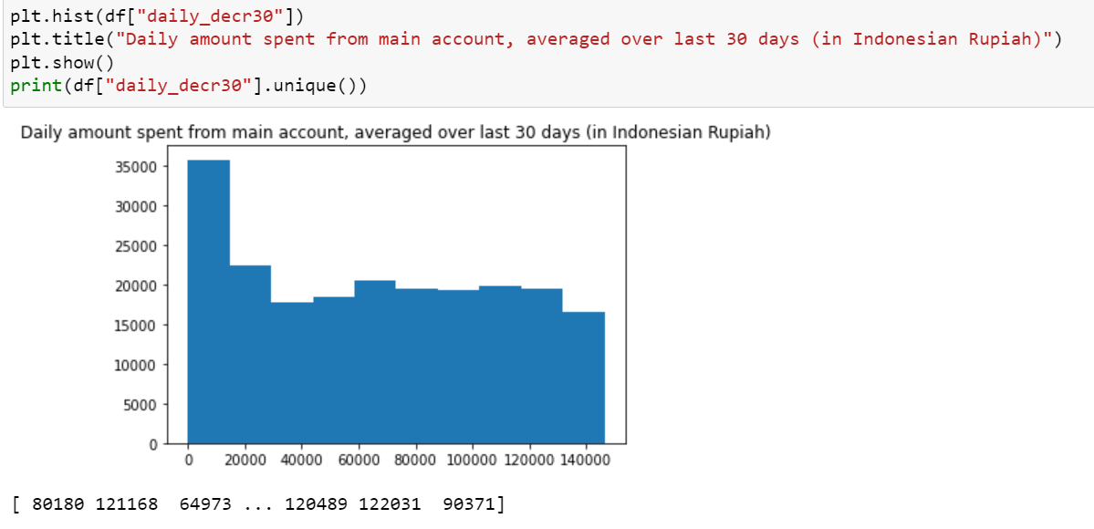
DATA VISUALIZATION

Slide 17
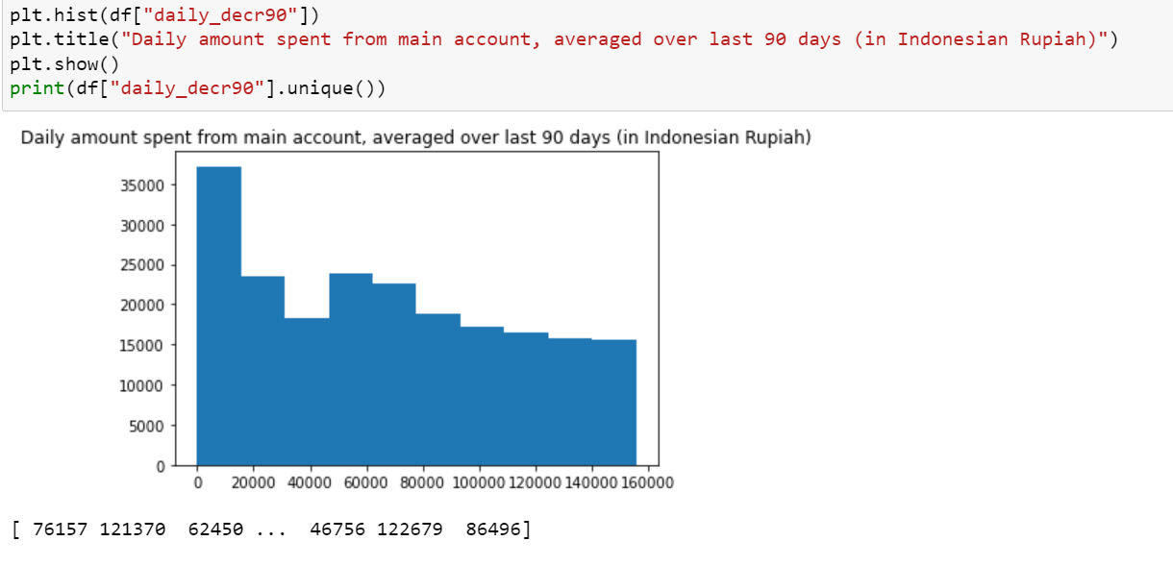
DATA VISUALIZATION

Slide 18
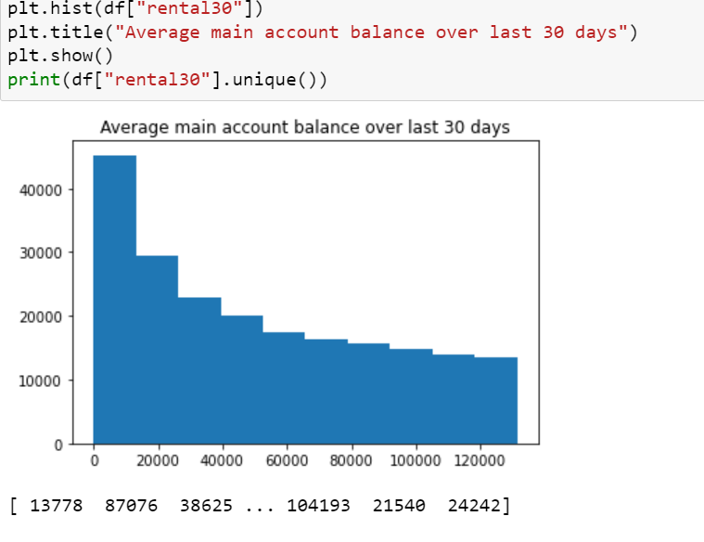
DATA VISUALIZATION

Slide 19
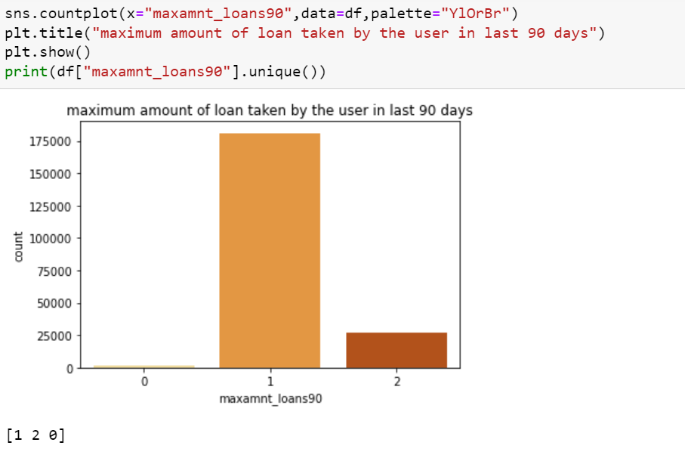
DATA VISUALIZATION

Slide 20
DATA PREPROCESSING DONE
Importing the necessary dependencies and libraries.
Reading the CSV file and converted into data frame.
Checking the data dimensions for the original dataset.
There are no null values in our dataset.
We have an imbalanced dataset, which we solved using SMOTE.
Checking the summary of the dataset.
Checking unique values.
Checking all the categorical columns in the dataset and converted the same into numerical using LabelEncoder.
Scaled the dataset using StandardScaler method.
Checking for multi collinearity using VIF.
Performed PCA
Performed Feature Importance using ExtraTrees Regression.

Slide 21
MODEL SELECTION
All the regression machine learning algorithms used are:
Logistic Regression Model
Decision Tree Model
AdaBoost Model
SVM Model
Random Forest Classifier Model

Slide 22
CONTD..
I have used Logistic Regression, Decision Tree, Random Forest Classifier, Support Vector Classifier, AdaBoost Classifier. Among these algorithms I would go with Random Forest Classifier. As the dataset was imbalanced, the other algorithms may overfit and may give inaccurate predictions whereas Random Forest can control overfitting and give best predictions.

Slide 23
CONCLUSION
From the given dataset it is clear that most of the customers are willing and inclined to repay the loan, as 87.5% of the customers repaid the loan and only 12.5% of the customers are defaulter.
Most of the customers have the intentions of repaying the loan. There are very few numbers of people , who are not inclined to repay.

